Slide 1


Slide 2
Concurrency 2
Advanced Concurrency

Slide 3
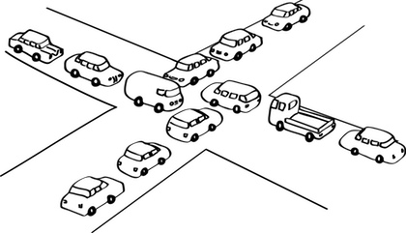
Concurrency
Recall the concepts of concurrency and parallelism:
Concurrency is the term we use for when logical operations overlap in time
Parallelism is the term we use for when logical operations are being executed at the same time
Notes:
Can be found online… but I can’t link to it

Slide 4
Concurrency
Threading is the most common concurrency model
In order to safely and effectively work with shared resources in the presence of concurrency, it is necessary to use tools like Mutexes/Locks
Notes:
Can be found online… but I can’t link to it

Slide 5
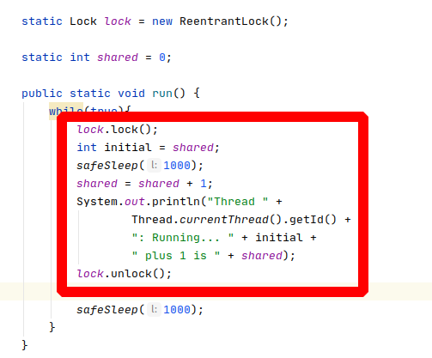
Concurrency
Java provides low level classes for dealing with concurrency
Last time we looked at the ReentrantLock which implements locking for safe access to critical sections of code
Notes:
Can be found online… but I can’t link to it

Slide 6
Today
Today we are going to look at higher-level concurrency tools that java makes available to you
Some concurrency tricks that may be useful at some point
Alternative concurrency models that avoid some of these complications
Notes:
Can be found online… but I can’t link to it

Slide 7
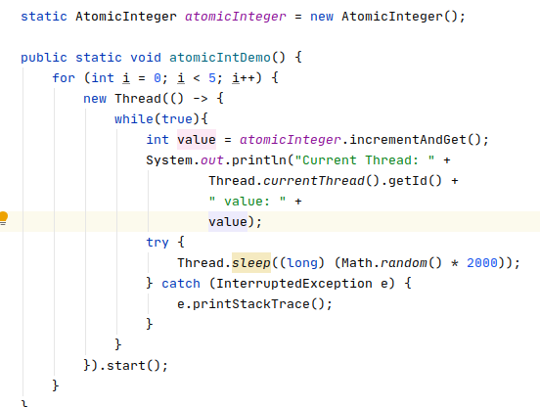
Higher Level Concurrency
AtomicInteger - a class that wraps an integer and provides atomic that is “thread safe” access to it’s value
In this code we create five threads that are all accessing the shared data atomicInteger
Notes:
Can be found online… but I can’t link to it

Slide 8
Higher Level Concurrency
You will recall from last time that to do this safely we needed to wrap access to the shared value in a Lock
AtomicInteger abstracts that away and gives you atomic methods such as incrementAndGet() to safely increment and get the value
DEMO
Notes:
Can be found online… but I can’t link to it

Slide 9
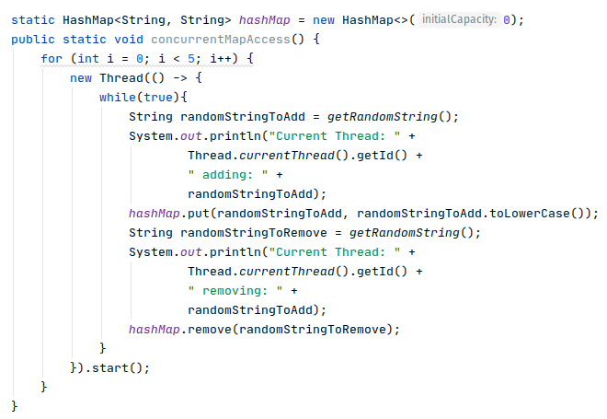
Higher Level Concurrency
AtomicInteger is somewhat useful, but what about sharing data structures such as a List or Map?
Consider some concurrent code that shares a hash map, putting and removing random strings from it
Notes:
Can be found online… but I can’t link to it

Slide 10
Higher Level Concurrency
Here there are five threads, all adding and removing random strings from a hashmap concurrently
This code turns out to be extremely dangerous!
Notes:
Can be found online… but I can’t link to it

Slide 11
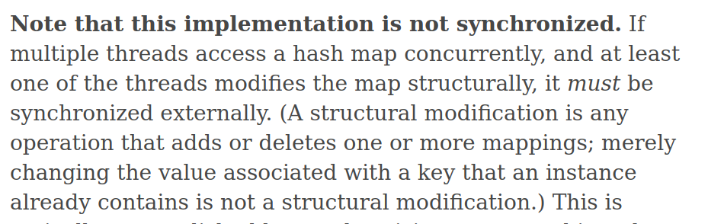
Higher Level Concurrency
If you were to allow this code to run long enough you would likely find one or more of the threads in a difficult-to-understand infinite loop!
Notes:
Can be found online… but I can’t link to it

Slide 12
Higher Level Concurrency
This shows the hazards of concurrent programming:
Difficult to understand semantics
Difficult to debug failures
Failures are non-deterministic: something may run just fine for a long time and then, suddenly, break
Notes:
Can be found online… but I can’t link to it

Slide 13

Higher Level Concurrency
Fortunately for us, Java offers a few solutions to this problem
Solution 1, create a synchronized decorator of the map
Notes:
Can be found online… but I can’t link to it

Slide 14
Higher Level Concurrency
This will properly synchronize access and mutation within the hashmap so that there will not be internal corruption
Unfortunately, since every get and put are synchronized, this means that only one thread at a time can update or read from the Map
This hurts parallelism
Notes:
Can be found online… but I can’t link to it

Slide 15

Higher Level Concurrency
Java has a solution that allows for more parallelism but retains thread safety: ConcurrentHashMap
ConcurrentHashMap will allow non-conflicting accesses to proceed in parallel, while still properly synchronizing updates to the maps internals
Notes:
Can be found online… but I can’t link to it

Slide 16
Higher Level Concurrency
ConcurrentHashMap is a widely used class in large, multi-threaded java applications
As you would expect, there are other concurrent data structure classes that can be found in the java.util.concurrent package
Notes:
Can be found online… but I can’t link to it

Slide 17
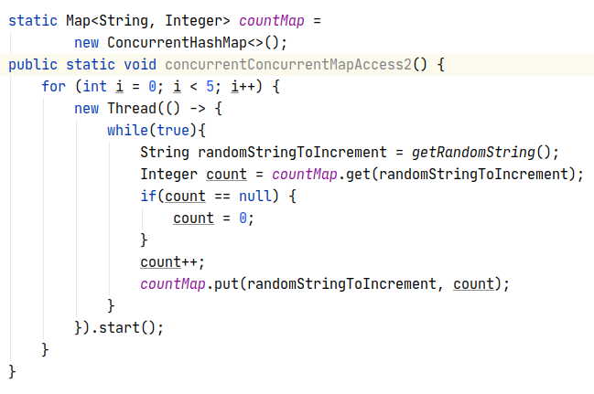
Higher Level Concurrency
Consider the code at right
We use a ConcurrentHashMap to keep track of the number of times a string has been accessed in the map
Is this code thread safe?
Notes:
Can be found online… but I can’t link to it

Slide 18
Higher Level Concurrency
NO
We are mutating the count value outside of any locking protection
Notes:
Can be found online… but I can’t link to it

Slide 19
Higher Level Concurrency
Thread 1: retrieves count for “A” which is 1 then pauses
Thread 2: retrieves count for “A” which is still 1 then pauses
Thread 1: updates the count to 2 and saves it
Thread 2: updates the count to 2 and saves it
Value is 2, even though 3 access have occurred!
Notes:
Can be found online… but I can’t link to it

Slide 20
Higher Level Concurrency
Again, this demonstrates how hard it is to get multithreaded code right
To do this properly, you would need to put a lock around the entire read/update/save critical section
Notes:
Can be found online… but I can’t link to it

Slide 21
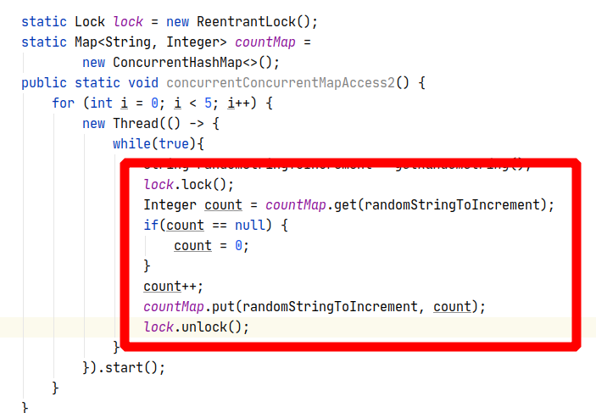
Higher Level Concurrency
Now things are safe, but you’ve destroyed the concurrency in this section of the code: only one thread at a time can update a count value
Maybe that’s OK, maybe not
Again, this is why concurrency is so hard to get right
Notes:
Can be found online… but I can’t link to it

Slide 22
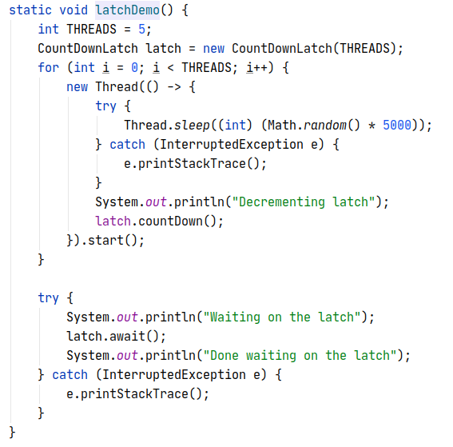
Higher Level Concurrency
So, we’ve looked at how to manage data that threads access, but what about managing threads themselves?
Notes:
Can be found online… but I can’t link to it

Slide 23
Higher Level Concurrency
We’ve already seen a few tools for helping coordinate threads:
join() - when called on a Thread object, the current thread will wait until that thread exits to continue
Semaphors - can be used to coordinate threads (e.g. a producer/consumer situation)
Notes:
Can be found online… but I can’t link to it

Slide 24
Higher Level Concurrency
At right is some code that uses another tool: a Latch
A latch can be used to coordinate threads by offering two functions:
A countDown() method which decrements the latch count
An await() method which causes the current thread to wait until the latch is at 0
Notes:
Can be found online… but I can’t link to it

Slide 25
Higher Level Concurrency
Here we have five threads that all decrement the latch at some random time in the future
The main thread waits until all these threads are complete before continuing
Much cleaner than joining each thread
Notes:
Can be found online… but I can’t link to it

Slide 26
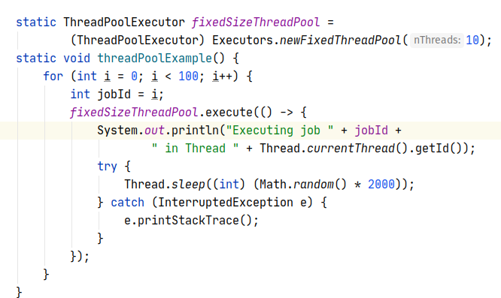
Higher Level Concurrency
Are Threads free? Can we just have as many threads as we want?
No
Threads are expensive
You often want to control the number of threads in your system
Notes:
Can be found online… but I can’t link to it

Slide 27
Higher Level Concurrency
To help you deal with this, Java offers Executors which provide a ThreadPoolExecutor
A Thread Pool is a set of threads that can be reused to execute taks or jobs
A very common pattern in large applications
Notes:
Can be found online… but I can’t link to it

Slide 28
Higher Level Concurrency
The code at right creates a fixed size thread pool with 10 threads
We submit tasks to the thread pool
The tasks are farmed out to the threads to execute
When a thread is done with a task it becomes available for a new one
Notes:
Can be found online… but I can’t link to it

Slide 29
Higher Level Concurrency
Contrast this with creating 100 threads to handle these 100 tasks
That would certainly be better parallelism
But it could also overwhelm your system with too many threads
Typically better to cap parallelism
Notes:
Can be found online… but I can’t link to it

Slide 30
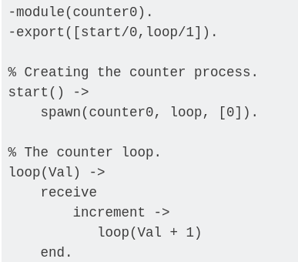
Message Passing
If all of this seems complex and error prone to you, yes, yes it is
Concurrent programming using traditional approaches, even with good libraries like Java provides, is notoriously error prone
Even good programmers screw it up, sometimes badly
Notes:
Can be found online… but I can’t link to it

Slide 31
Message Passing
Some programming languages have address this problem by implementing message passing
At right is an example of Erlang, a famous message-passing based language
Notes:
Can be found online… but I can’t link to it

Slide 32
Message Passing
The counter process effectively acts like a very light-weight, single thread
Isolates all data locally to that module
The “function” is “invoked” via message passing
Notes:
Can be found online… but I can’t link to it

Slide 33
Message Passing
This approach has proven very effective for building highly concurrent, large scale systems
Adopted by some other programming languages as well (e.g. go)
Notes:
Can be found online… but I can’t link to it

Slide 34
Message Passing
As of today, still not widely adopted in the broader industry
Very popular in specific areas like telecom
Becoming more popular in other areas as well
Notes:
Can be found online… but I can’t link to it

Slide 35
Review
Today we talked about some more advanced concurrency tools
AtomicInteger - thread safe sharing of a single integer
ConcurrentHashMap - thread safe sharing of a hashmap data structure
Latches - A simple way to coordinate multiple threads
ThreadPools - A way to keep the number of threads in your system under control by reusing existing threads
Even with these higher-level constructs, concurrency can be very hard to get right!
Some languages use “message passing” with isolated environments between code units to implement simpler concurrency
Becoming more and more popular

